Slide 1
COMP1204: XPath in Practice
Oli Bills
ofb@ecs.soton.ac.uk

Slide 2
This week
Today
XPath in Detail
Applying XPath to XSLT
Tomorrow
Swarm Robotics
Thursday
Lab 3 Tutorial

Slide 3
XPath
XML Path Language
Query language
Path: Hierarchic addressing
Addressing parts of an XML Document
Although not just for XML
XPath 3.0 can be used for JSON as well
Used with host languages – e.g. XQuery, XSLT etc.
Frequently used on the web today
To select from the DOM
Built-in support
Third party support, e.g. jQuery
Frequently used when parsing data files, configuration files etc.

Slide 4
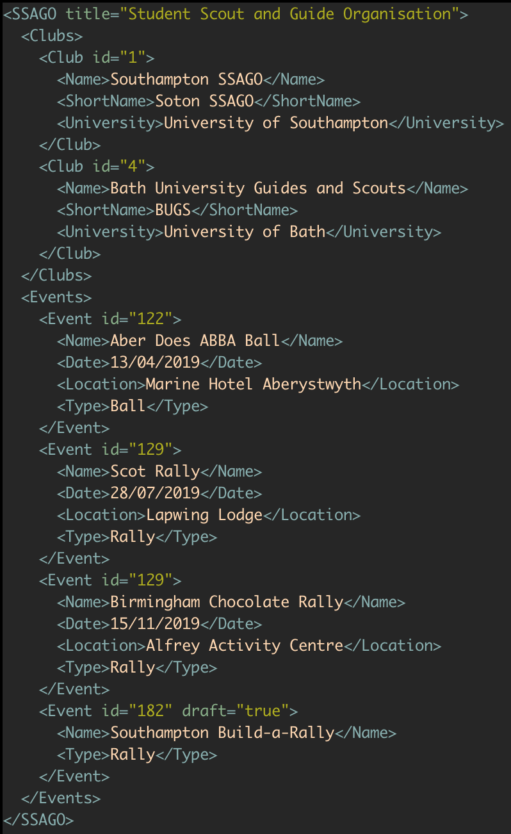




Example XML
Selective export of some of the SSAGO database in XML format

Slide 5
XPath: Getting a node
Task: Getting a specific node in the hierarchy
The root starts at /
Use a / to separate each part of the path
Will return multiple matches if multiple elements match the path
Syntax: /path/to/element

Slide 6
XPath: Try it out
https://ecs.ninja/xml
Left side shows you the XML we are working with
Right side at the top you can enter your Xpath
Right side at the bottom will show you the results

Slide 7
XPath: Getting a node
Task: Get the entire SSAGO Node
https://ecs.ninja/xml

Slide 8
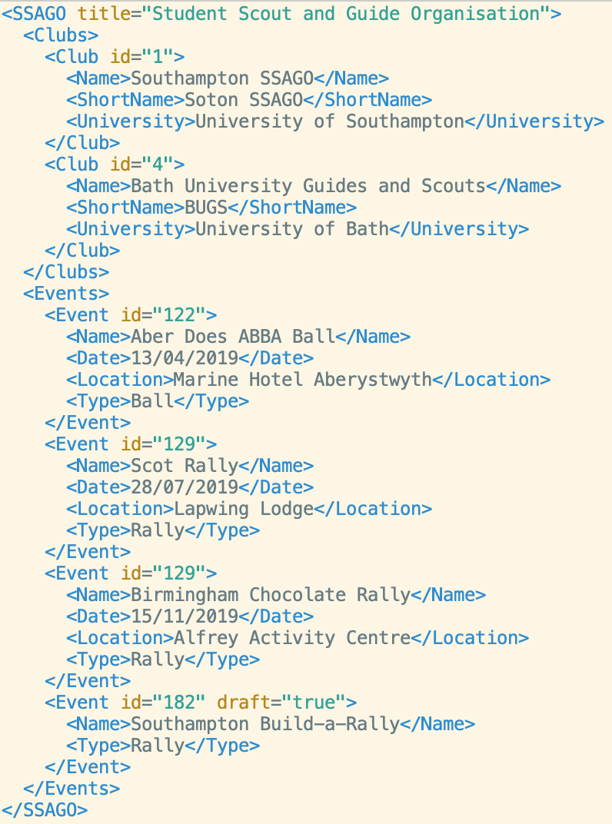
XPath: Getting a node
Query: /SSAGO Result:

Slide 9
XPath: Getting a node
Task: Get the entire Clubs Node
https://ecs.ninja/xml

Slide 10
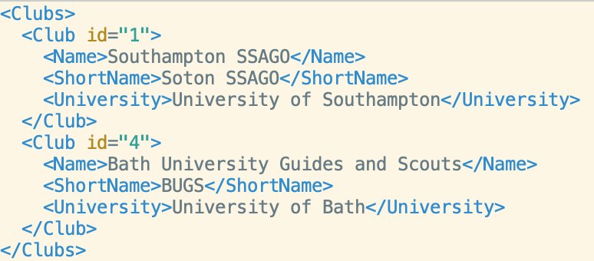
XPath: Getting a node
Query: /SSAGO/Clubs Result:

Slide 11
XPath: Getting a node
Task: Get every Club Node
https://ecs.ninja/xml

Slide 12
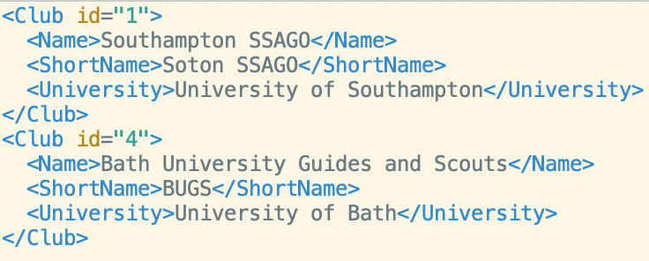
XPath: Getting a node
Query: /SSAGO/Clubs/Club Result:
Multiple <Club> elements returned

Slide 13
XPath: Getting all nodes
Use // to find all nodes that match
Use * to match any node
//* = all nodes
//Node = any Nodes
//Node1/Node2 = all Node2s under any Node1

Slide 14
XPath: Getting all nodes
Task: Get every Name Node, regardless of Event or Club

Slide 15
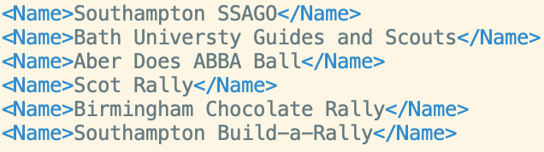
XPath: Getting all nodes
Query: //Name

Slide 16
XPath: Getting all nodes
Task: Get every Location Node

Slide 17
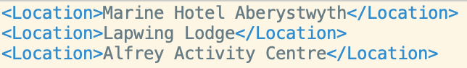
XPath: Getting all nodes
Query: //Event/Location

Slide 18
XPath: Indirect nodes
You can use // in the middle of paths as well
For example
/Node1//Node3
/Node1//Node3/Node4
/Node1//Node3//Node5

Slide 19
XPath: Indirect nodes
Query: //Clubs//Name

Slide 20
XPath: Getting attributes
Attributes are referenced using an @
//@Attribute
//Node/@Attribute
/Node1/Node2/@Attribute

Slide 21
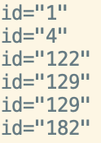
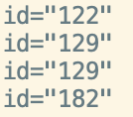
XPath: Getting attributes
Query: //@id
Query: //Event/@id

Slide 22
XPath: Indirect nodes and attributes
Task: Get the ID of every club

Slide 23
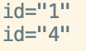
XPath: Indirect nodes and attributes
Query: //Club//@id

Slide 24
XPath: Getting text
text() returns any text directly inside the element
But not children
//Node/text()
/Node1/Node2/text()
/Node1/*/text()

Slide 25
XPath: Getting text
Task: Get just the text value of every club name

Slide 26
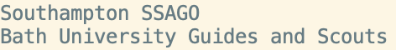
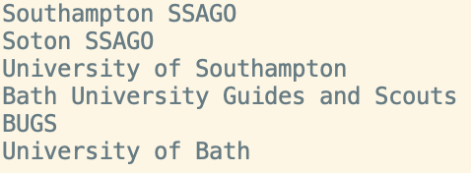
XPath: Getting text
Query: /SSAGO/Clubs/Club/Name/text()
Query: //Clubs//Name/text()
Query: //Clubs//text()

Slide 27
XPath: Getting everything
//* = All nodes
//text() = All text
//@* = All attributes

Slide 28
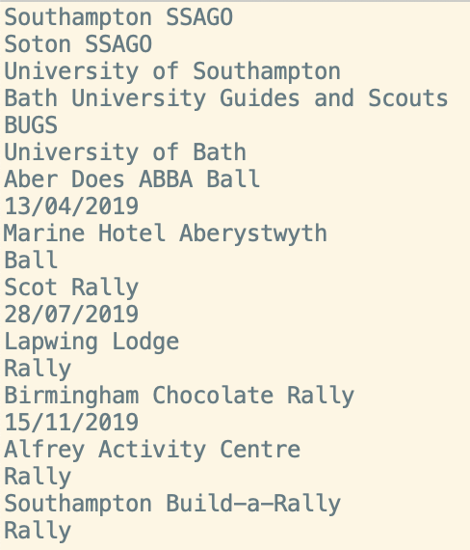
XPath: Getting everything
Query: //text()

Slide 29
XPath: Numerical referencing
You can reference by numbered position
There is a special last() function to refer to the last node
/node[1]
/node[2]
/node[n]
/node[last()-1]
/node[last()]
/node1[1]/node2[3]

Slide 30
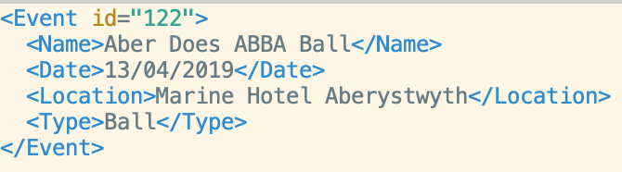
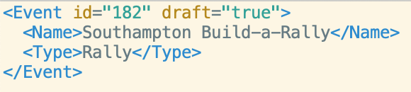
XPath: Numerical referencing
Query: //Event[1]
Query: //Event[last()]

Slide 31
XPath: Numerical referencing
Task: Get the text value name of the last event

Slide 32
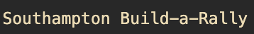
XPath: Numerical referencing
Query: //Event[last()]/Name/text()

Slide 33
XPath: Filtering by node
You can use filtering to restrict the results based on criteria
//Node1[Node2]
Get only a Node1 with a Node2
//Node1[Node2=“Value”]
Get only a Node1 with a Node2 with given value

Slide 34
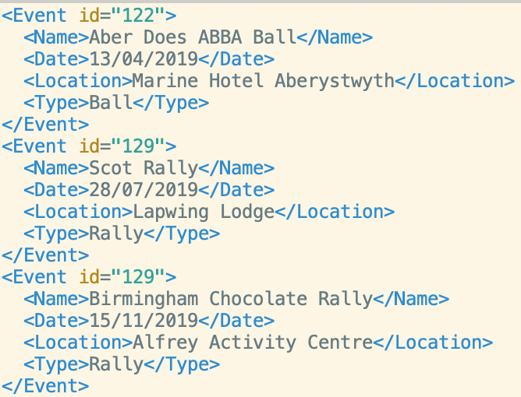
XPath: Filtering by node
Query: //Event[Location]

Slide 35
XPath: Filtering by node
Task: Get the Ball event, by type

Slide 36
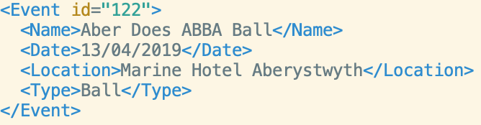
XPath: Filtering by node
Query: //Event[Type=“Ball”]

Slide 37
XPath: Filtering by attribute
Works the same way
But you use the attribute notation (@)
/Node[@Attribute]
Nodes with attribute
/Node[@Attribute=“Value”]
Nodes with attribute equal to value
/Node[@Attribute>Value]
Doesn’t just have to be equals!
Can mix with wildcards too
//*[@id]
Get all nodes with an id attribute

Slide 38
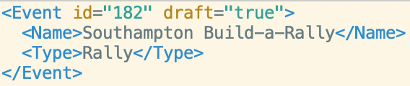
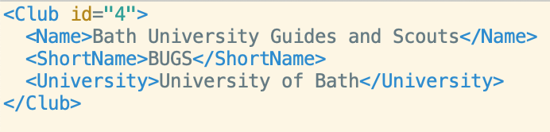
XPath: Filtering by attribute
Query: //Event[@draft]
Query: //Club[@id=4]

Slide 39
XPath: Filtering by text
Query: //*[text()=“Southampton SSAGO”

Slide 40
XPath: Navigation
Like folders
. = current
.. = parent
../.. = parent’s parent

Slide 41
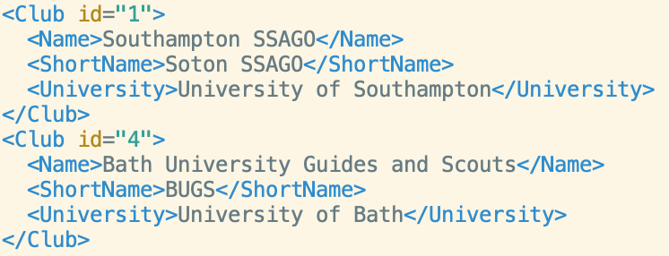
XPath: Navigation
Query: //ShortName/..

Slide 42
XPath: Text and navigation
Task: Get the parent of anything with the text “Southampton SSAGO”

Slide 43
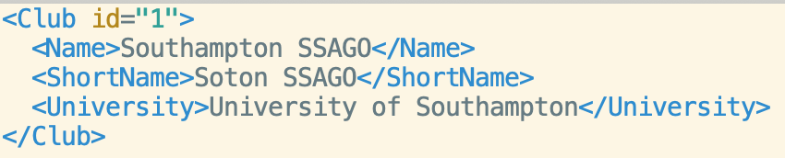
XPath: Text and navigation
Query: //*[text()="Southampton SSAGO"]/..

Slide 44
XPath: Using Boolean Logic
You can use OR and AND as you would expect with filtering
/Node[@attribute=value or @attribute=value2]
You can use | to join XPaths together
//Node1|//Node2
Will get all Node1 and Node2
You can use not
//Node1[not(node2)]
Get Node1 that doesn’t have a node2

Slide 45
XPath: Using Boolean Logic
Task: Get Club 1 or 4

Slide 46
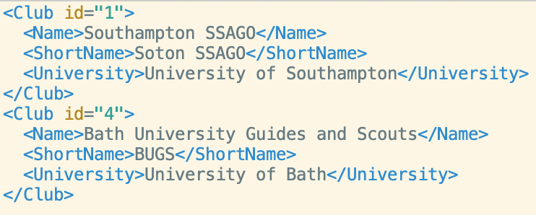
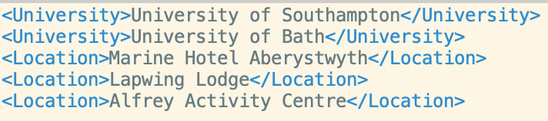
XPath: Using Boolean Logic
Query: //Club[@id=1 or @id=4]
Query: //University|//Location

Slide 47
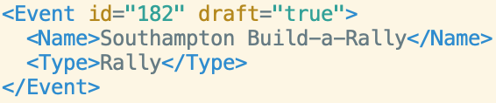
XPath: Using Boolean Logic
Query: //Event[not(Location)]

Slide 48
XPath: String functions
contains(node,”text”)
contains(@attribute,”text”)
string-length
starts-with
ends-with
/Node[contains(@attribute,”ttext”)]

Slide 49
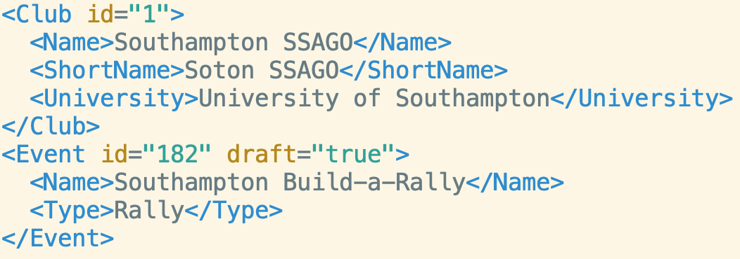
XPath: Putting it all together
Task: Get any Club or Event node (but not other possible nodes) that contains any node with text to do with “Southampton”
Query: //Event/*[contains(text(),"Southampton")]/..
|//Club/*[contains(text(),"Southampton")]/..

Slide 50
XPath: More functions
There are many more functions
More advanced functionality
https://www.w3.org/TR/xpath-functions-31/

